Slide 1
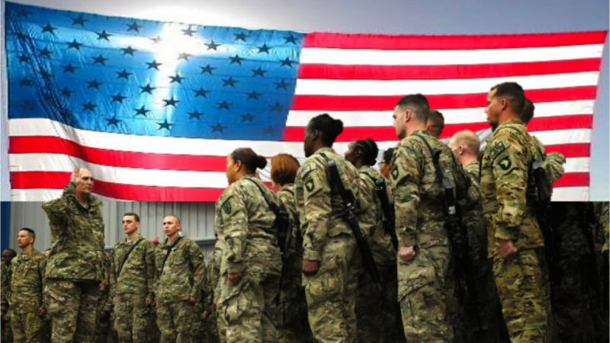
Military Pathways
Service, Careers, Education, and Community

Slide 2
Army
College ROTC
National Guard
Reserves
Enlisted
Warrant Officer
Officer
Military College
Air Force
College ROTC
National Guard
Reserves
Enlisted
Officer
Military College
Coast Guard
College ROTC
Reserves
Enlisted
Officer
Military College
Marine
College ROTC
Reserves
Enlisted
Warrant Officer
Officer
Military College
Navy
College ROTC
Reserves
Enlisted
Officer
Military College
Space Force
Enlisted
Officer
NEW

Slide 3
General Overview
College ROTC
Serve while in college through college unit
Branch is based on college
$$ for being in ROTC
Partial to full tuition repayment after college
4 to 8 year Active-Duty Officer commitment at the end of college
National Guard/ Reserves
Take ASVAB
Choose a branch of service and career field
Attend 6-12 weeks of Basic Training
Attend Career Field Training 3months to 2 years
4-year guard commitment (Serve 1 weekend a month and 2 weeks a year )
Inactive reserves until 8 years
College assistance through GI Bill and Tuition Assistance
3 or more high school ROTC courses may increase pay grade / rank
Military College
Applications and Interview are similar to a 4-year college
Additional Physical requirements may apply
May or may not be affiliated with a specific branch of service
Letters of recommendation may include community & government officials
High school ROTC does help, but not required
Active-Duty Officer commitment after college depends on the school
Active Duty Enlisted
Take ASVAB
Choose a branch of service and career field
3-to-6 year commitment based on contract
Inactive reserves until 8 years
College assistance through Post 9/11 GI Bill and up to 100% Tuition Assistance while active duty
3 or more high school ROTC courses may increase pay grade / rank
**some branches have warrant officers and officer with an associates degree
Active-Duty Officer
Take ASVAB
Must have a 4-year degree or higher
Choose a branch of service and career field
NG/ reserve officers are normally enlisted first
4 or more years commitment based on contract
Inactive reserves until 8 years
College assistance through Post 9/11 GI Bill and up to 100% Tuition Assistance while active duty
Age, Citizenship, & Education limits may vary

Slide 4
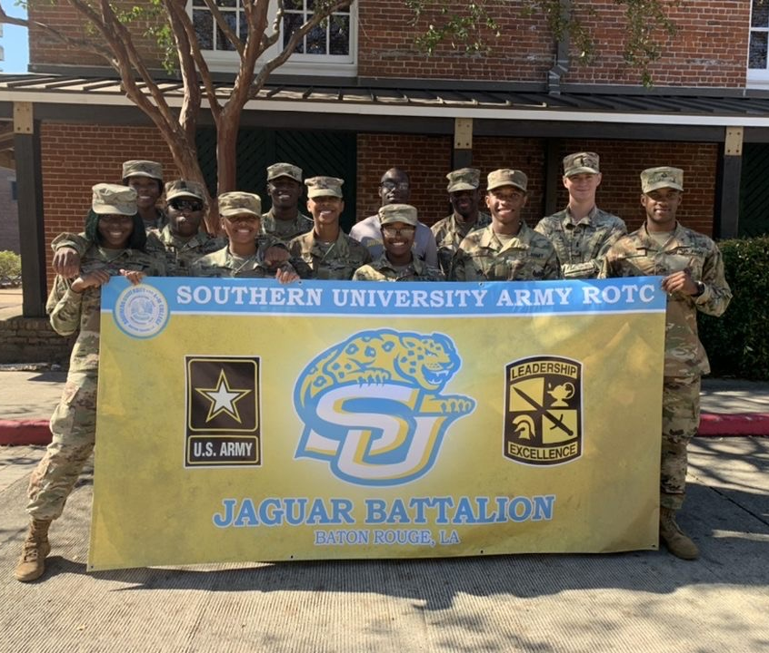
College ROTC
Serve while in college through college unit
Partial to full tuition repayment after college
4 to 8 year Active-Duty Officer commitment at the end of college
Branch is based on college
$$ for being in ROTC

Slide 5
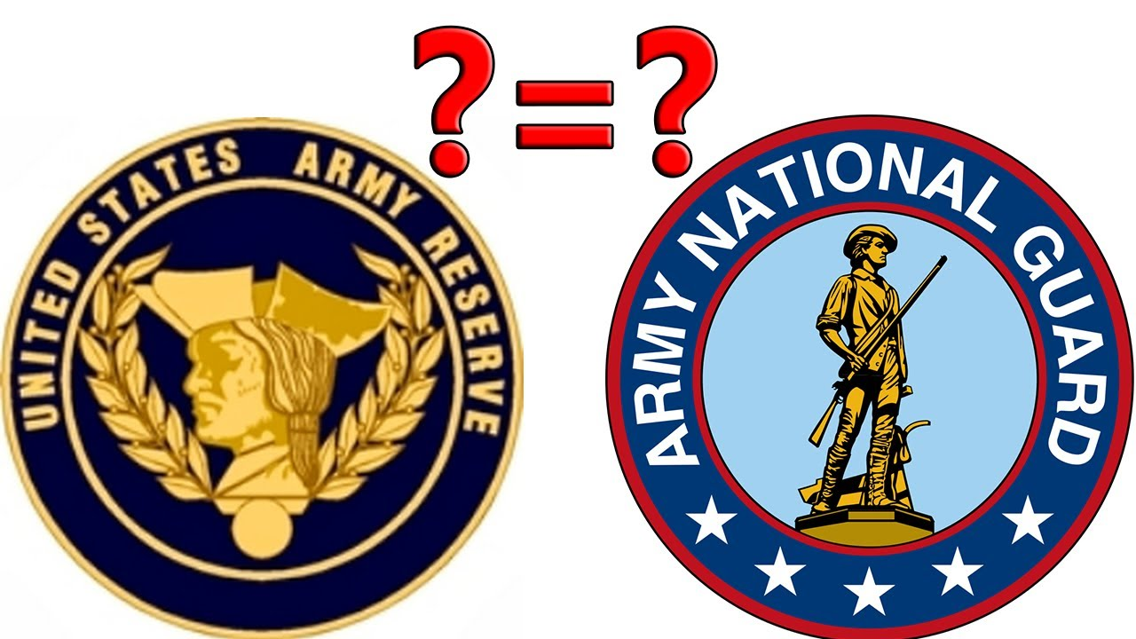
National Guard/ Reserves
Take ASVAB
Choose a branch of service and career field
Attend 6-12 weeks of Basic Training
Attend Career Field Training 3months to 2 years
4-year guard commitment (Serve 1 weekend a month and 2 weeks a year )
Inactive reserves until 8 years
College assistance through GI Bill and Tuition Assistance
3 or more high school ROTC courses may increase pay grade / rank

Slide 6
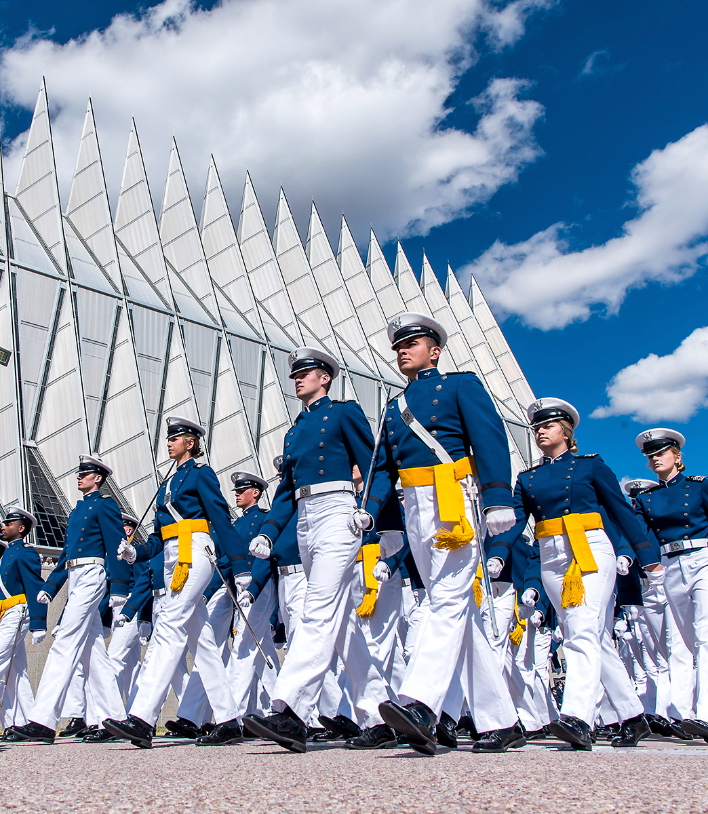
Military College
Applications and Interview are similar to a 4-year college
Additional Physical requirements may apply
May or may not be affiliated with a specific branch of service
Letters of recommendation may include community & government officials
High school ROTC does help, but not required
Active-Duty Officer commitment after college depends on the school

Slide 7
Military College
Service Academy | Location | Acceptance Rate
U.S. Military Academy | West Point, NY | 10%
U.S. Naval Academy | Annapolis, MD | 8%
U.S. Air Force Academy | Colorado Springs, CO | 11%
U.S. Coast Guard Academy | New London, CT | 20%
U.S. Merchant Marine Academy | Kings Point, NY | 15%
Service Academy | Location | Acceptance Rate
The Citadel | Charleston, NC | 81%
Norwich University | Northfield, VA | 66%
Virginia Military Institute | Lexington, VA | 51%
blog.collegevine.com/guide-to-military-colleges
veteran.com/senior-military-colleges/

Slide 8
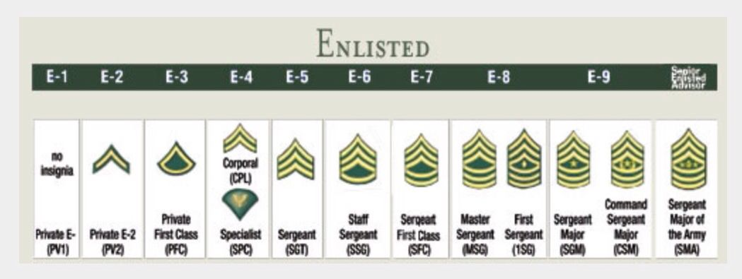
Active Duty Enlisted
Take ASVAB
Choose a branch of service and career field
3-to-6 year commitment based on contract
Inactive reserves until 8 years
College assistance through Post 9/11 GI Bill and up to 100% Tuition Assistance while active duty
3 or more high school ROTC courses may increase pay grade / rank
**some branches have warrant officers and officer with an associates degree

Slide 9
Active-Duty Officer
Take ASVAB
Must have a 4-year degree or higher
Choose a branch of service and career field
NG/ reserve officers are normally enlisted first
4 or more years commitment based on contract
Inactive reserves until 8 years
College assistance through Post 9/11 GI Bill and up to 100% Tuition Assistance while active duty

Slide 10
Army
Air Force
Coast Guard
Marine
Navy
Space Force
goarmy.com
airforce.com
uscg.mil
marines.com
navy.com
spaceforce.mil
Find your local branch recruiters @ Bit.ly/mphsMILITARY

