Slide 1
Career and College Promise

Slide 2
Why participate in this program?
Expand elective options: CCP offers courses that MPHS does not offer (Such as…Welding, Criminal Justice, Early Childhood Ed, Fire Protection)
Continue program options that enhance your current MPHS experience (Such as…Automotive, Engineering, Business/Marketing, Culinary Arts)
Earn college credit beyond the AP/IB course offerings at MPHS (Such as…Art Appreciation, Public Speaking, Sociology, Astronomy)

Slide 3
Other Benefits
100% tuition and fees are waived during Fall and Spring terms
Textbooks are subsidized with a $50 electronic stipend for EACH class enrolled usable at the CPCC bookstore
Summer School is an option – But only tuition waived, NOT fees. $75 online/$150 face-to-face Textbook subsidy not available during summer

Slide 4
Two Programs Available
CTE Technical Pathway
Each pathway when completed leads to a technical certification (over 50 pathways to choose from)
MPHS Course weight is 4.0 (standard level)
College Transfer Pathway
These courses have been approved by the University of North Carolina system for college transfer credit if a C or higher is earned in the course.
MPHS Course weight is 5.0 (AP/IB level)

Slide 5
How do I qualify for the program?
Must be a junior or senior
Must be on-track for graduation
CTE Technical Pathways require WEIGHTED GPA = 2.6
Beginning Fall 2019:
College Transfer Pathway require UNWEIGHTED GPA = 2.8 OR College Entrance Exam Scores (scores can be combined)
PSAT Pre-ACT or ACT SAT
English 26 or 460 English 18 English/Reading 480
Reading 26 or 460 Reading 22
Math 24.5 or 510 Math 22 Math 530

Slide 6
How many pathways can I select?
You can choose up to 2 pathways each semester 2 CTE Technical pathways OR 1 Transfer pathway & 1 CTE Technical pathway
You can change your pathways EACH semester Students apply to this program EVERY semester - Allowing them the opportunity to change their pathways - Their GPA at MPHS and CPCC is reviewed

Slide 7
CTE Technical Pathways (#) indicates multiple programs
Advertising and Graphic Design (3)
Architectural Technology (4)
Automotive Technology (3)
Biomedical Equipment Technology
Business Administration
Civil Engineering (2)
Computer Integrated Machining
Construction Management (4)
Cosmetology
Criminal Justice
Culinary Arts (5)
Early Childhood Education (3)
Electrical Engineering
Fire Protection
Geomatics (2)
Graphic Arts and Imaging (2)
Health Science (3)
Horticulture (4)
Human Services Technology (2)
Information Technology
Interior Design
Interpreter Education
Mechatronics Engineering
Mechanical Engineering
Non-Destruction Examination
Nurses Aide (CNA)
Simulation and Game Development (2)
Sustainability Technology
Welding Technology (2)

Slide 8
College Transfer Pathway
Associates in Arts
Associates in Science
Associates in Engineering
Associates in Visual Arts
Can I earn an Associates Degree while in High School? YES

Slide 9
How do I apply?
Career and College Promise Application Process:
1. Apply to CPCC to get a CPCC ID# You officially become a CPCC student. You only do this ONCE. This CPCC ID# is assigned to you for life and you never apply for another one!
2. Setup your CPCC Login & Password for CPCC’s MyCollege This is the CPCC version of PowerSchool. Grades, transcripts, registration, tuition payments, financial aid are handled through MyCollege.
3. Apply to Career and College Promise to MPHS This application creates the communication between MPHS and CPCC that places you in the Career and College Promise program. Without this step you cannot register for courses at CPCC.
4. Return the signed Student/Parent contract to MPHS. You cannot take classes at CPCC unless you have parent permission because you are not a high school graduate.
https://mphscollegeandcareercenter.weebly.com/

Slide 10
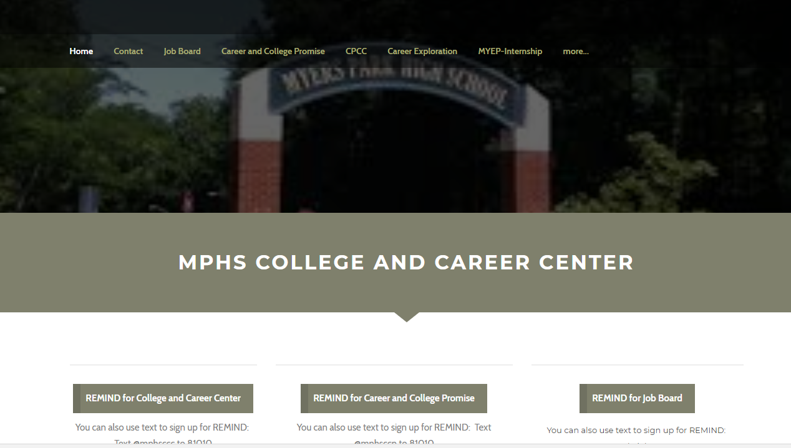
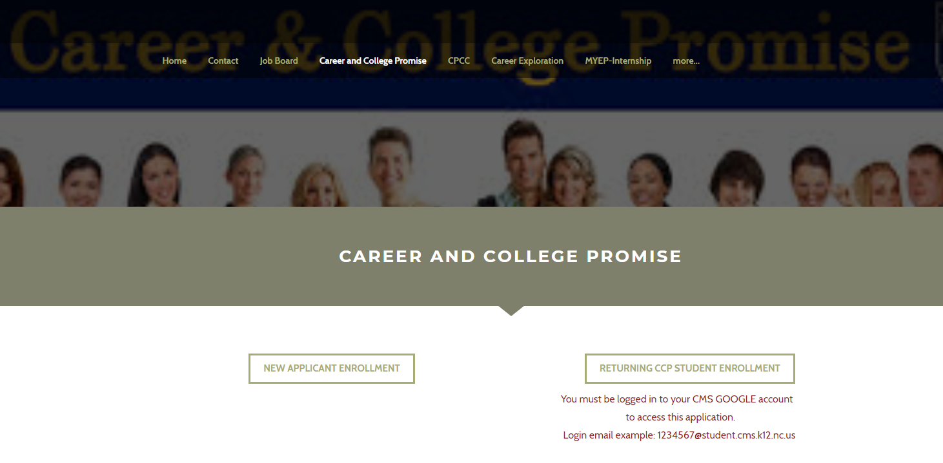
How do I get the application?
Access the application by using the College and Career Center accessible from the Myers Park High School home page
Select Student Resources / Academic Resources / College and Career Center / Career and College Promise. OR
https://mphscollegeandcareercenter.weebly.com/

Slide 11
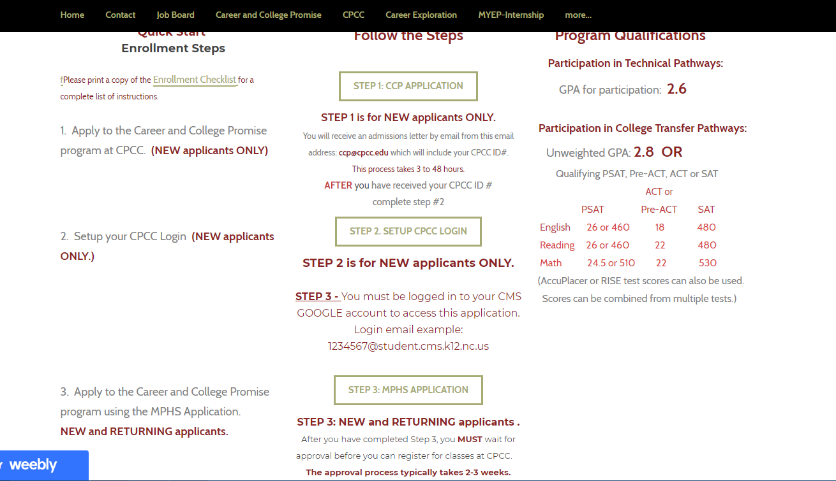
Application Process using the Website

Slide 12
How do I earn my Associates Degree?
An Associates Degree requires 60 college credit hours (15 credits for 4 semesters = approximately 5 classes per semester).
This leaves little room for classes at MPHS during junior & senior year.
Students aiming to reach this goal should prepare themselves like an IB student: Complete Math III, 3 sciences (Earth & Environmental, Biology, and Chemistry or Physics) and level 2 or 3 foreign language by the end of sophomore year.
There are a few classes at CPCC that will satisfy high school graduation requirements: HIS 131 = American History I; HIS 132 = American History II; the 4th HS Math can be satisfied at CPCC. ENG 111 at CPCC does not equal HS English 3.

Slide 13
Commonly asked questions/comments:
I’m in the IB program so I cannot take classes at CPCC.
FALSE: IB students have at least 1 elective class each year. This course can be ANYTHING. Students can take a CPCC course instead of an additional unneeded IB course to fill this spot in their schedule.
I’m in the IB program so I cannot complete an Associates Degree.
TRUE: IB requires a commitment of 7 courses at MPHS during the junior and senior year to complete the IB program and 8 courses at MPHS to complete a full high school schedule. You cannot take 7-8 classes at MPHS and 5 classes at CPCC. You cannot be a full-time student at both schools.
I can’t participate in clubs or sports if I take classes at CPCC.
FALSE: You are dual enrolled at both schools. You can participate in all sports and clubs at your high school as well as extra-curricular activities at CPCC. You are a student at both campuses.
I do not have transportation to Central Campus, so I can’t take classes.
FALSE: CPCC offers many online courses. CPCC Central Campus is also on the bus and trolley route.

Slide 14
Commonly asked questions/comments:
I play sports, have a AP and Honors classes at MPHS, I’m in clubs, I work a job, and babysit. This makes me ineligible to take classes at CPCC.
Anyone who meets the academic criteria for the Career and College Promise program and apply within the deadlines can take classes at CPCC. Students must be realistic with their time commitments for other academic work and outside school activities. WHAT IS YOUR PRIORITY? – Be realistic about your time before committing to college classes.
I have 2nd block “free”. How do I find a CPCC class that fits this time slot?
CPCC runs on a college schedule. They do not recognize the 4X4 or A/B schedules at MPHS. You must find/take classes at CPCC that do not interfere with your MPHS schedule. That may include classes after 2:30 or 1:45 if you have early dismissal. That may include a night class, a Saturday morning class, or an online class. MPHS scheduling attempts to arrange classes at the beginning or the end of the day at MPHS to give you larger time blocks to take classes at CPCC.
How will CPCC classes be viewed when I apply to colleges?
CPCC courses are ACTUAL college courses. Colleges are encountering students frequently as dual enrollment programs gain popularity across the country. Public universities in NC are required to view dual enrollment courses as similar and equal to IB or AP courses when reviewing your application for college admission. Whether you are enrolled in AP, IB, or dual enrollment courses, you must still perform well to prove your academic readiness.

Slide 15
Commonly asked questions/comments:
Do CPCC instructors know I am a high school student and provide me with extra assistance since I am still in high school?
This is a college course. College instructors are not aware of who is a “high school student” and who is a “college student”. They treat everyone the same. MPHS/CMS is not in a position to step in to “help”.
What if I do poorly in my CPCC classes?
You must maintain your GPA to remain in the program. Doing poorly could remove you from the program.
Classes at CPCC will appear on your CPCC transcript as well as your MPHS transcript and calculate into your CPCC and MPHS GPA’s. Performing poorly in your college classes can certainly “hurt” your college applications. Performing well can help your college application stand out as prepared, ready, and proven for the college classroom environment at a 4-year university.
I have an IEP or 504 plan. Does this make me ineligible to take classes?
Your eligibility for the program is strictly based upon your GPA and college entrance exam scores. If you do have an IEP or a 504 plan they will not follow you to college. You must seek college services through the Office of Disabilities at CPCC.

Slide 16
What if I have the GPA but not the college entrance exam scores?
Some students have the needed GPA – unweighted 2.8 - but do not have qualifying entrance exam scores. Do I need both?
Beginning in the Fall of 2019, you only need a qualifying GPA OR college entrance exam scores. You do NOT need both. If you do not have the qualifying GPA or college entrance exam scores and need to take the CPCC placement test to qualify for the College Transfer pathway, you may take the CPCC placement exam. It is free. It is given 2X per day Monday-Friday at each campus. There is an English/Reading and Math component.
What is a Provisional Student? GPA 3.5+ no exam scores
The provisional student option has been removed from the program as of Fall 2019 term.

