Slide 1
Career and College Promise

Slide 2
Why participate in this program?
Expand elective options: CCP offers courses that MPHS does not offer (Such as…Welding, Criminal Justice, Business, Fire Protection)
Continue program options that enhance your current MPHS experience (Such as…Automotive, Engineering, Business/Marketing, Culinary Arts)
Earn college credit beyond the AP/IB course offerings at MPHS (Such as…Art Appreciation, Public Speaking, Sociology, Astronomy)

Slide 3
Other Benefits
100% tuition and fees are waived during Fall and Spring terms
Textbooks are subsidized with an electronic stipend for EACH class enrolled (usable at the CPCC bookstore)
Summer School is an option – Only tuition waived, NOT fees.
$75 online/$125 face-to-face
Textbook subsidy not available during summer

Slide 4
Two Programs Available
CTE Technical Pathway
Each pathway when completed leads to a technical certification (over 50 pathways to choose from)
MPHS Course weight is dependent on course
College Transfer Pathway
These courses have been approved by the University of North Carolina system for college transfer credit if a C or higher is earned in the course.
MPHS Course weight is 5.0 (AP/IB level)

Slide 5
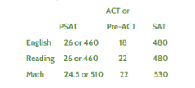
How do I qualify for the program?
Must be a junior or senior
Must be on-track for graduation
CTE Technical Pathways: UNWEIGHTED GPA = 2.8 OR high school recommendation from school counselor
College Transfer Pathway: UNWEIGHTED GPA = 2.8 OR College Entrance Exam Scores (scores can be combined)
College Entrance Scores Chart

Slide 6
How many pathways can I select?
You can choose up to 2 pathways each semester
2 CTE Technical pathways OR
1 Transfer pathway & 1 CTE Technical pathway
You can change your pathways EACH semester
Students apply to this program EVERY semester
Allowing them the opportunity to change their pathways
Their GPA at MPHS and CPCC is reviewed

Slide 7
Technical Pathways (Over 50)
CTE Technical Pathways (subject to change)
Advertising & Graphic Design Intro Graphic Design
Advertising & Graphic Design Intro Graphic Design Web
Architectural Technology – Accelerated CAD/BIM
Architectural Technology – Specialization in Sustainability
Architectural Technology Residential Architecture
Automotive Technology Automotive Systems Diploma
Automotive Technology Collision, Repair and Refinishing
Automotive Technology: Brakes and Alignment
Biomedical Equipment Technology
Business Administration
Computer Integrated Machining Certificate
Construction Management Diploma
Construction Management Entry Level Construction
Construction Management- Fast Track Carpentry
Construction Management Green Building
Construction Management Technology - Supervision
Cosmetology
Criminal Justice Basics of Criminal Justice
Culinary Arts – Certified Fundamentals Cook (*$600 fee)
Culinary Arts – Specialization in Baking (*$600 fee)
Culinary Arts – Specialization in Cold Foods (*$600 fee)
Culinary Arts Culinary Skills (*$600 fee)
Diesel and Heavy Equipment Technology
Early Childhood Beginnings in Early Childhood
Electrical Systems Technology - Diploma
Fire Protection Basics of Fire Protection
Geomatics Technology- Certificate
Graphic Arts and Imaging Technology Flexographic Print
Health Science Fundamentals of Medical Assisting
Health Science Fundamentals of Pharmacy Technology
Heating, Ventilation, and Air Conditioning (Coming soon)
Horticulture Technology - Intro Landscape Management
Horticulture Technology – Urban Agriculture
Horticulture Technology Introduction to Horticulture
Human Services Technology - Certificate
Information Technology Info Tech Fundamentals
Interior Design Intro to Interior Design
Interpreter Education
Mechanical Engineering Tech - Specialize in Mechanical
Mechatronics Engineering
Non-Destructive Examination – Surface Examination
Nurse Aid Certificate (CNA)
Office Administration – Receptionist
Office Administration - Specialist
Simulation and Game Development Certificate
Simulation and Game Development Diploma
Sustainability Technologies- Renewable Energy
Turfgrass Management
Welding Technology Advanced Welding Automation
Welding Technology SMAW Steel Welding

Slide 8
College Transfer Pathway (Click to Explore)
Arts Transfer
Fine Arts Transfer
Music
Theatre
Visual
Science Transfer
Engineering Transfer
CMS PreCal should be complete prior to applying
Teacher Preparation Transfer
Art (General Ed)
Science
You can earn an Associates Degree while in High School if you start your Junior year!
Click here to explore degrees.

Slide 9
How do I apply?

Slide 10
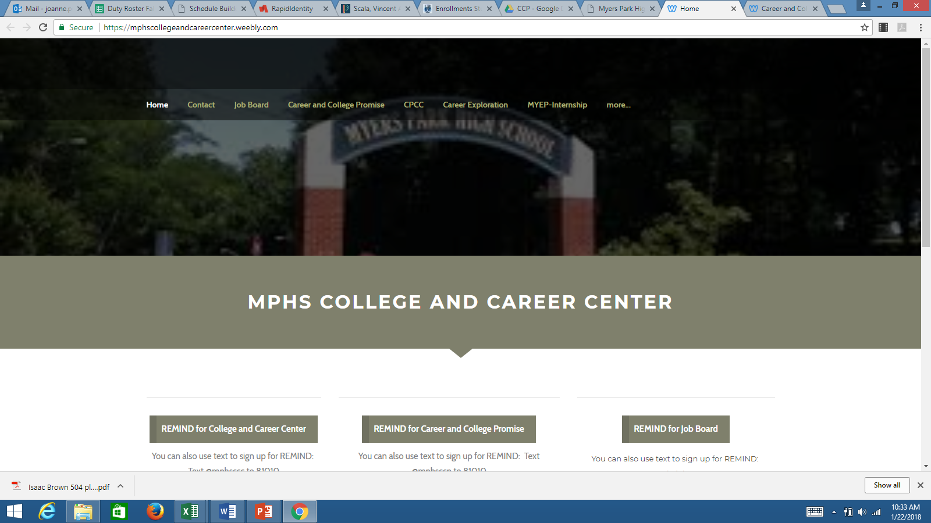
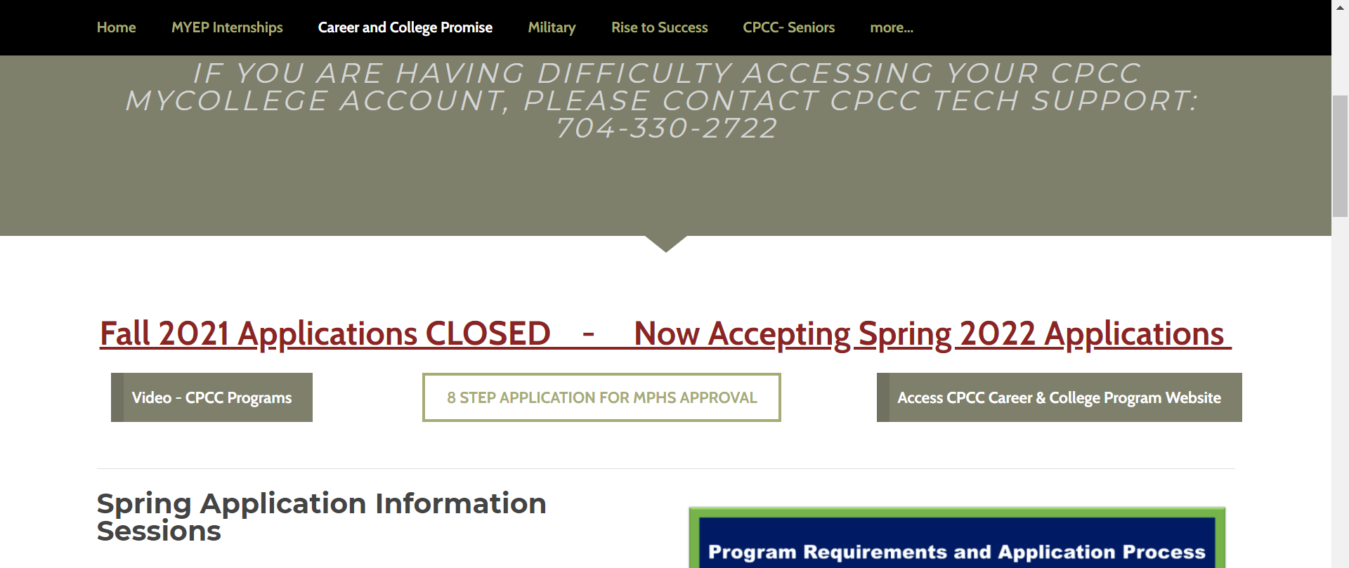
How Do I Apply?
How do I get the application?
https://mphscollegeandcareercenter.weebly.com/
OR
https://bit.ly/mphsCCP - will take you directly to

Slide 11
Application Process using the Website
What Steps do I take in the Applciation?

Slide 12
How do I earn my Associates Degree?
Associates Degree requires 60 college credit hours
15 credits for 4 semesters = approximately 5 classes per semester
This leaves little room for classes at MPHS during 11th & 12th grade.
Students aiming to reach this goal should prepare themselves like an IB student by completing the following by the end of 10th grade:
Math III
3 sciences (Earth & Environmental, Biology, and Chemistry or Physics)
Level 2 or 3 foreign language
Double up on a history if you have room
Helpful hints to boost course availability: Take 1 NCVPS course the summer after your sophomore year one of the following:
ENG 3
American History
Classes at CPCC that will satisfy high school graduation requirements:
American History= 2 courses HIS131 and HIS132
World History= 2 Courses HIS111 and HIS112
MAT 143/ 152/ 171 / 271 = 4th HS Math
ENG 111 at CPCC does not equal HS English 3.

Slide 13
Commonly asked questions/comments:
I’m in the IB program so I cannot take classes at CPCC.
FALSE: IB students have at least 1 elective class each year. This course can be ANYTHING. Students can take a CPCC course instead of an additional unneeded IB course to fill this spot in their schedule.
I’m in the IB program so I cannot complete an Associates Degree.
TRUE: IB requires a commitment of 7 courses at MPHS during the junior and senior year to complete the IB program and 8 courses at MPHS to complete a full high school schedule. You cannot take 7-8 classes at MPHS and 5 classes at CPCC. You cannot be a full-time student at both schools.
I can’t participate in clubs or sports if I take classes at CPCC.
FALSE: You are dual enrolled at both schools. You can participate in all sports and clubs at your high school as well as extra-curricular activities at CPCC. You are a student at both campuses.
I do not have transportation to Central Campus, so I can’t take classes.
FALSE: CPCC offers many online courses. CPCC Central Campus is also on the bus and trolley route.

Slide 14
Commonly asked questions/comments:
I play sports, have AP and Honors classes at MPHS, I’m in clubs, I work a job, and babysit. This makes me ineligible to take classes at CPCC.
Anyone who meets the academic criteria for the Career and College Promise program and apply within the deadlines can take classes at CPCC. Students must be realistic with their time commitments for other academic work and outside school activities. WHAT IS YOUR PRIORITY? – Be realistic about your time before committing to college classes.
I have 2nd block “free”. How do I find a CPCC class that fits this time slot?
CPCC runs on a college schedule. They do not recognize the 4X4 or A/B schedules at MPHS. You must find/take classes at CPCC that do not interfere with your MPHS schedule. That may include classes after 2:30 or 1:45 if you have early dismissal. That may include a night class, a Saturday morning class, or an online class. MPHS scheduling attempts to arrange classes at the beginning or the end of the day at MPHS to give you larger time blocks to take classes at CPCC.
How will CPCC classes be viewed when I apply to colleges?
CPCC courses are ACTUAL college courses. Colleges are encountering students frequently as dual enrollment programs gain popularity across the country. Public universities in NC are required to view dual enrollment courses as similar and equal to IB or AP courses when reviewing your application for college admission. Whether you are enrolled in AP, IB, or dual enrollment courses, you must still perform well to prove your academic readiness for college.

Slide 15
Commonly asked questions/comments:
Do CPCC instructors know I am a high school student and provide me with extra assistance since I am still in high school?
This is a college course. College instructors are not aware of who is a “high school student” and who is a “college student”. They treat everyone the same. MPHS/CMS is not in a position to step in to “help”.
What if I do poorly in my CPCC classes?
You must maintain your GPA to remain in the program. Doing poorly could remove you from the program.
Classes at CPCC will appear on your CPCC transcript as well as your MPHS transcript and calculate into your CPCC and MPHS GPA’s. Performing poorly in your college classes can certainly “hurt” your college applications. Performing well can help your college application stand out as prepared, ready, and proven for the college classroom environment at a 4-year university.
I have an IEP or 504 plan. Does this make me ineligible to take classes?
Your eligibility for the program is strictly based upon your GPA and/or college entrance exam scores. If you do have an IEP or a 504 plan, it will not follow you to college. You must seek college services through the Office of Disabilities at CPCC.

