Slide 1
Career and College Promise
Spring 2024 Deadline Nov 4th
Summer/ Fall 2024 Deadline April 4th

Slide 2
Why participate in this program?
Expand elective options: CCP offers courses that MPHS does not offer (Such as…Welding, Criminal Justice, Business, Fire Protection)
Continue program options that enhance your current MPHS experience (Such as…Automotive, Engineering, Business/Marketing, Culinary Arts)
Earn college credit beyond the AP/IB course offerings at MPHS (Such as…Art Appreciation, Public Speaking, Sociology, Astronomy)

Slide 3
Other Benefits
100% tuition and fees are waived during Fall and Spring terms
Ebooks are free for CMS Students (usable at the CPCC bookstore)
Summer School is an option – Only tuition waived, NOT fees.
Est $75 online/$125 face-to-face

Slide 4
How do I qualify for the program?
CTE Technical Pathway
Each pathway when completed leads to a technical certification (over 40 pathways to choose from)
MPHS Course weight is dependent on course
Must be a junior or senior
Must be on-track for graduation
CTE Technical Pathways: UNWEIGHTED GPA = 2.8 OR high school recommendation from school CDC with lower

Slide 5
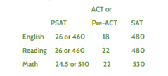
How do I qualify for the program?
College Transfer Pathway
These courses have been approved by the University of North Carolina system for college transfer credit if a C or higher is earned in the course.
MPHS Course weight is 5.0 (AP/IB level) College Transfer
Must be a junior or senior
Must be on-track for graduation
UNWEIGHTED GPA = 2.8 OR College Entrance Exam Scores (scores can be combined)
College Entrance Scores Chart

Slide 6
How many pathways can I select?
You can choose up to 2 pathways each semester
Student that qualify are suggested to choose arts pathway
You can change your pathways EACH semester
Students apply to this program EVERY semester

Slide 7
Technical Pathways
CTE Technical Pathways (subject to change)
Career and Technical Pathways (2.8 uGPA)
​Accounting and Finance
Business Administration – Marketing
Cosmetology Pathway (additional departmental requirements)
Culinary Arts (additional departmental requirements)
Electronics Engineering Technology
Emergency Medical Science Certificate (additional departmental requirements)
Emergency Medical Science Diploma (additional departmental requirements)
Information Technology
IT Java Programming
IT Javascript
IT Python
Nurse Aide Certificate (additional departmental requirements)
Career and Technical Pathways (2.6 GPA)
Advertising and Graphic Design - Intro to Graphic Design
Advertising and Graphic Design - Intro to Graphic Design for Web
Architectural Technology
Automotive Technology
Biomedical Equipment Technology
Business Administration - Business Operations
Business Administration – Specialization in Logistics
Business Administration – Project Management
Computer Integrated Machining
Construction Management - Green Building (C35190C7)
Criminal Justice
Early Childhood
Electrical Systems Technology
Geomatics Technology (requires test scores in math to be eligible)
Horticulture
Human Services Technology
HVAC - Specialization in Refrigeration Systems
Interior Design
Interpreter Education - Basic American Sign Language
Mechanical Engineering Technology
Mechatronics Engineering Technology
Medical Assisting
Medical Office Administration Certificate
Medical Office Administration - Procedural and Diagnostic Coding
Non-Destructive Examination
Pharmacy Technology
Simulation and Game Development
Sustainability Technologies
Welding Technology

Slide 8
College Transfer Pathway (Click to Explore)
*Arts Transfer (All New students start here)
Fine Arts Transfer
Music
Theatre
Visual
Science Transfer
Engineering Transfer
CMS PreCal should be complete prior to applying
Teacher Preparation Transfer
Art (General Ed)
Science
You can earn an Associates Degree while in High School if you start your Junior year!
Click here to explore degrees.

Slide 9
Arts Transfer Pathway | Science Transfer Pathway | Engineering Transfer Pathway | Visual Art Fine Arts Transfer Pathway | Music Fine Arts Transfer Pathway | Theatre Fine Arts Transfer Pathway | Teacher Prep Arts Transfer Pathway | Teacher Prep Science Transfer Pathway
Feeds into Associate in Arts Transfer Degree (correct choice for math or computer science) | Feeds into Associate in Science Transfer Degree (Biological or Physical Science) | Feeds into Associate in Engineering Transfer Degree *Start with ARTS if no High School PreCal or Cal AB | Feeds into Associate in Fine Arts in Visual Arts Transfer Degree | Feeds into Associate in Fine Arts in Music Transfer Degree | Feeds into Associate in Fine Arts in Theatre Transfer Degree | Feeds into Associate in Arts in Teacher Preparation | Associate in Science in Teacher Preparation
Courses English – 3 Humanities – 3 Social/Behavior – 3 Math – 1 OR MORE Science – 1 ACA 122 | Courses English – 3 Humanities – 2 Social/Behavior – 2 (Cannot be same course ) Math – 2 OR MORE Science – 2 ACA 122 *Cannot take Social Studies to Substitute MPHS courses. | Courses English – 2 Humanities – 1 ECO 251 Calculus 1 & 2* Science – 2 *must take MAT 171 & MAT 172 or place into Calculus *Cannot take Social Studies or English to Substitute MPHS courses. | Courses English – 2 Humanities – 2 Social/Behavior – 1 Math – 1 OR MORE Science – 1 Art – 2 ACA 122 | Courses English – 2 Humanities – 2 Social/Behavior – 1 Math – 1 OR MORE Science – 1 Music – 2 ACA 122 | Courses English – 2 Humanities – 2 Social/Behavior – 1 Math – 1 OR MORE Science – 1 Theater – 2 ACA 122 | Courses English – 3 Humanities – 3 Social/Behavior – 2 Math – 1 OR MORE Science – 1 Other – 1 ACA 122 | Courses English – 3 Humanities – 1 Social/Behavior – 2 Math – 2 OR MORE Science – 2 Other - 1 ACA 122
All classes are Uniform General Education Transfer Component (UGETC) classes and will transfer to schools within the UNC system Additional math courses can be taken in any transfer pathway but will not count toward pathway completion.
Optional – Foreign Language (Note that foreign language courses are not part of the UGETC The receiving university will determine whether the courses will count as general education, pre-major, or elective credit.)

Slide 10
How do I apply?
Myers Park Self Paced Information Session: ALL Students Each Semester
CPCC Application OR Send Transcript: ALL Students Each Semester
Set-Up CPCC Login: NEW applicants ONLY
CPCC Email: NEW applicants ONLY
Learning Platform BrightSpace: NEW applicants ONLY
CPCC Mandatory Orientation: ALL Students Each Semester
MPHS Application: ALL Students Each Semester

Slide 11
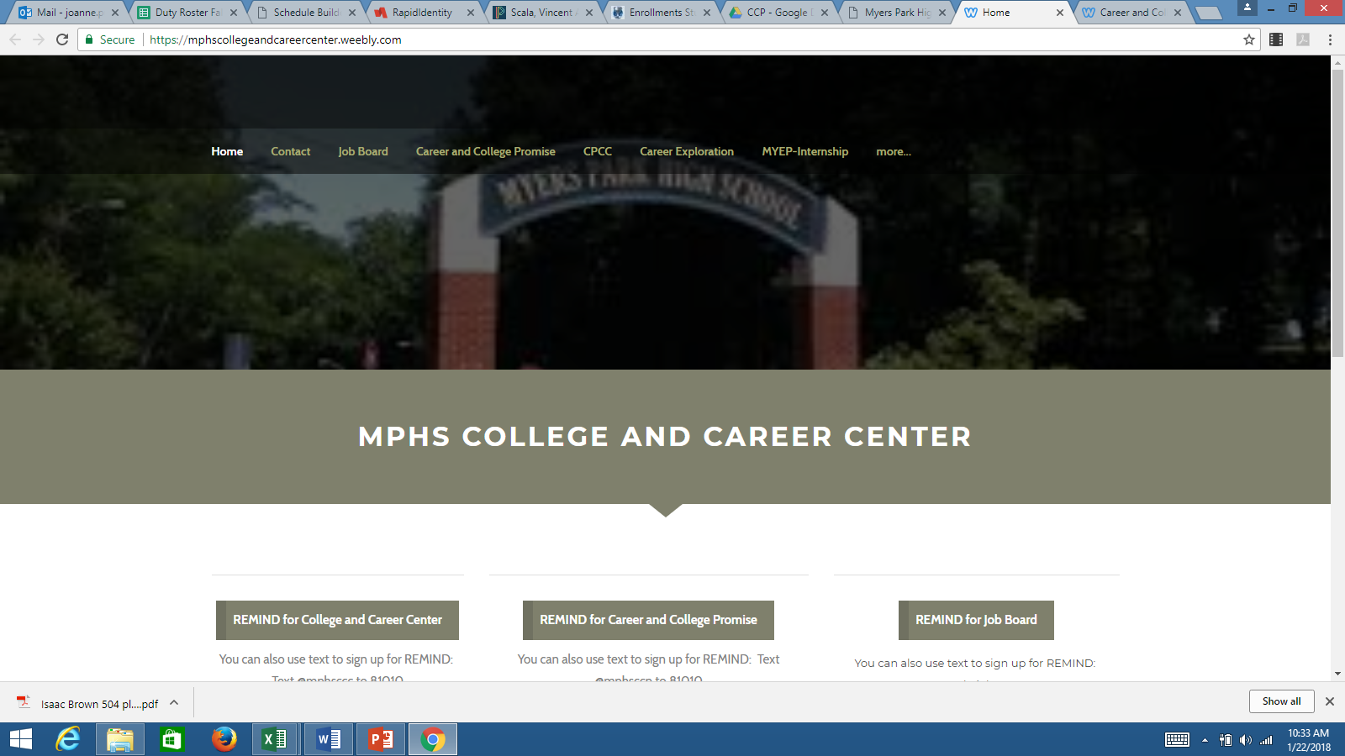
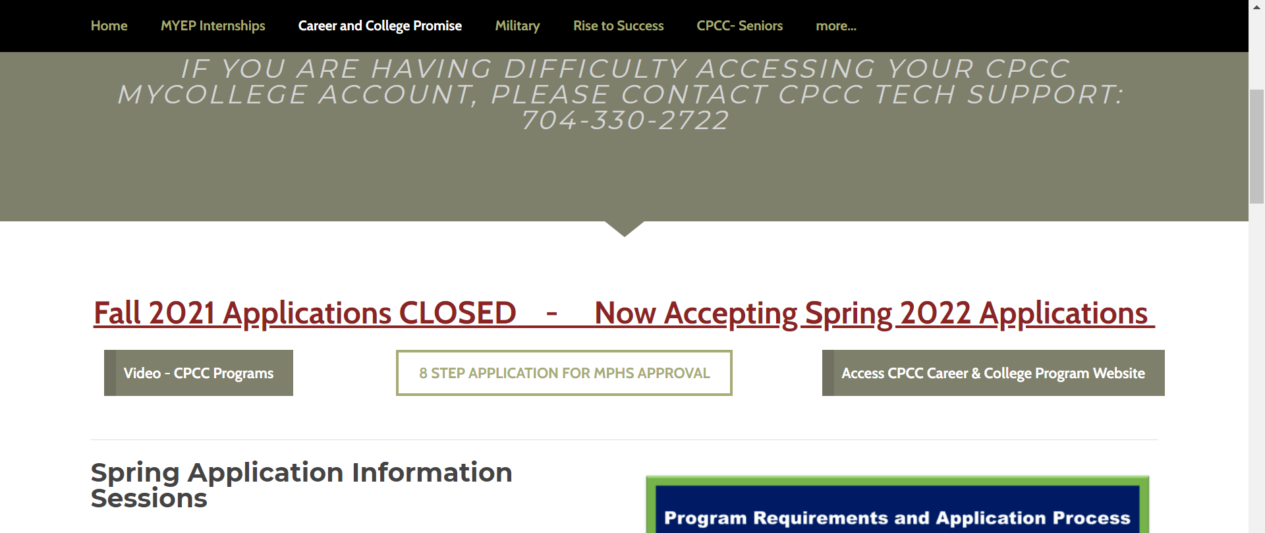
How Do I Apply?
How do I get the application?
tinyurl.com/MPHSCOLLEGEANDCAREER
Myers Park Home Page>Parents & Student>Student Support>College and Career
tinyurl.com/MPHSCCP

Slide 12
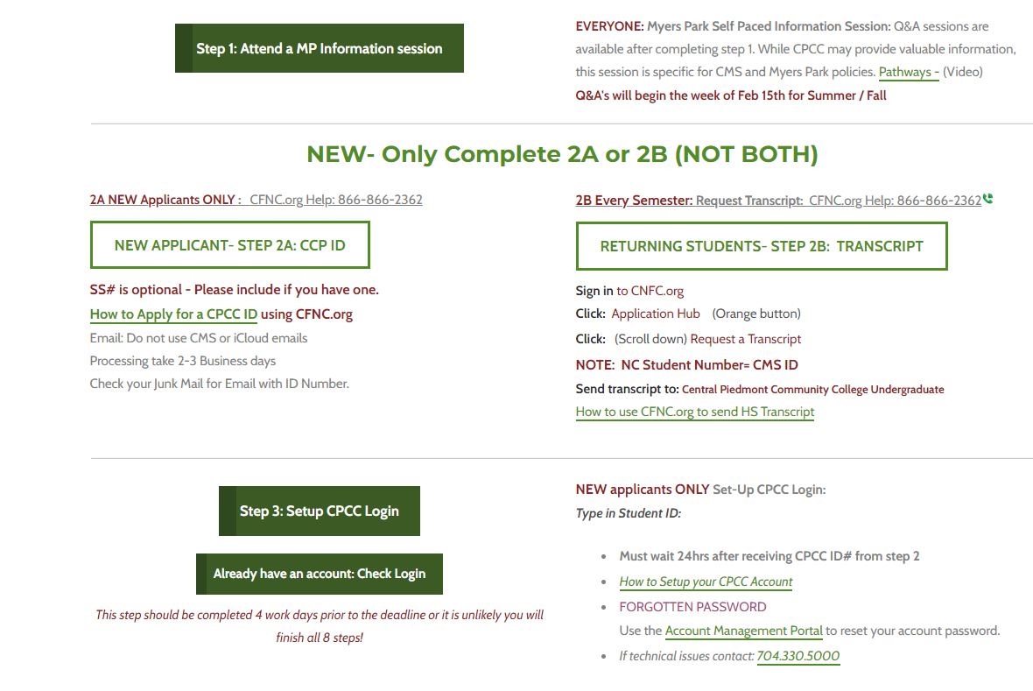
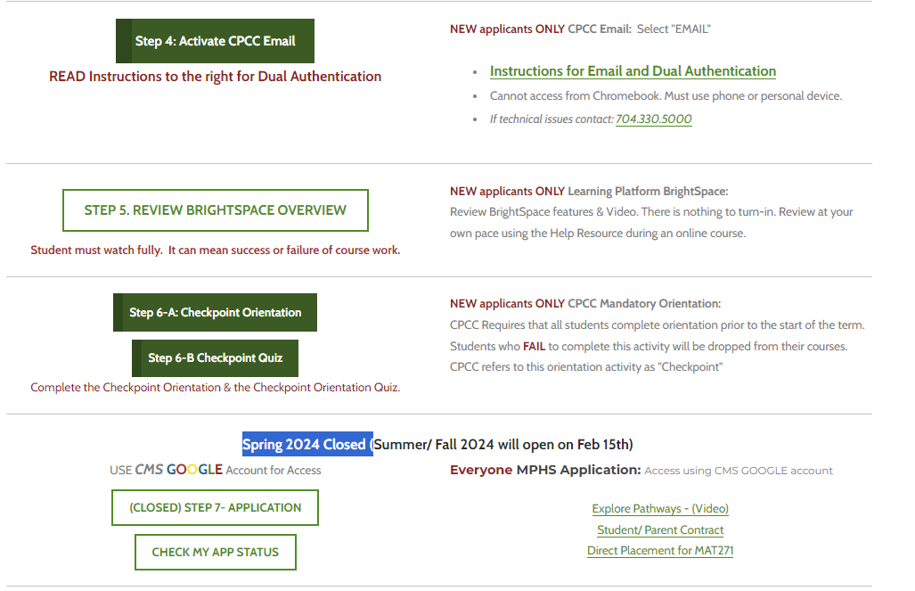
Application Process using the Website
What Steps do I take in the Application?

Slide 13
How do I earn my Associates Degree?
Associates Degree requires 60 college credit hours
15 credits for 4 semesters = approximately 5 classes per semester
This leaves little room for classes at MPHS during 11th & 12th grade.
Students aiming to reach an Associates degree should prepare like an IB student by completing the following by the end of 10th grade:
Math III
3 sciences (Earth & Environmental, Biology, and Chemistry or Physics)
Level 2 or 3 foreign language
Double up on a history if you have room
Helpful hints to boost course availability: Take 1-2 NCVPS courses the summer after your sophomore year one of the following:
ENG 3
American History or World History
Classes at CPCC that will satisfy high school graduation requirements:
American History= 2 courses HIS131 and HIS132
World History= 2 Courses HIS111 and HIS112
MAT 143/ 152/ 171 / 271 = 4th HS Math
ENG111, 112, and 24? = English 4
ENG 111 at CPCC does not equal HS English 3.

Slide 14
Commonly asked questions/comments:
Can IB Students take classes at CPCC.
Yes: IB students may take up to 3 summer CPCC classes or 1 CPCC course each semester online or after MPHS day.
Can student in IB program complete an Associates Degree.
No: Due to course limitations your commitment is to IB.
Can I participate in clubs or sports if I take classes at CPCC.
Yes: You are dual enrolled at both schools. You can participate in all sports and clubs at your high school as well as extra-curricular activities at CPCC. You are a student at both campuses. MPHS Coaches want you to take at least 2 in person MPHS blocks each semester for eligibility.
If I do not have transportation to Central Campus, can I still take classes.
Yes: CPCC offers many online courses. CPCC Central Campus is also on the bus and Gold Line route.

Slide 15
Commonly asked questions/comments:
Do CPCC instructors know I am a high school student and provide me with extra assistance since I am still in high school?
This is a college course. College instructors are not aware of who is a “high school student” and who is a “college student”. They treat everyone the same. MPHS/CMS is not in a position to step in to “help”.
What if I do poorly in my CPCC classes?
You must maintain your GPA to remain in the program. Doing poorly could remove you from the program or place you on probation for closer monitoring.
Classes at CPCC will appear on your CPCC transcript and MPHS transcript. Courses calculate into your CPCC and MPHS GPA’s. Performing poorly in your college classes can “hurt” your college applications. Performing well can help your college application stand out as prepared, ready, and proven for the college environment.
Is MPHS Parking Guaranteed? No- Seniors will follow normal procedures. Juniors are not guaranteed
I have an IEP or 504 plan. Can I use my accommodations at CPCC?
If you do have an IEP or a 504 plan, it will not follow you to college automatically. The student must seek college services through the Office of Disabilities at CPCC.

Slide 16
Commonly asked questions/comments:
I play sports, have AP and Honors classes at MPHS, I’m in clubs, I work a job, and babysit. This makes me ineligible to take classes at CPCC.
Anyone who meets the academic criteria for the Career and College Promise program and apply within the deadlines can take classes at CPCC. Students must be realistic with their time commitments for other academic work and outside school activities. WHAT IS YOUR PRIORITY? – Be realistic about your time before committing to college classes.
I have 2nd block “free”. How do I find a CPCC class that fits this time slot?
CPCC runs on a college schedule. They do not recognize the 4X4 or A/B schedules at MPHS. You must find/take classes at CPCC that do not interfere with your MPHS schedule. That may include classes after 2:30 or 1:45 if you have early dismissal. That may include a night class, a Saturday morning class, or an online class. MPHS scheduling attempts to arrange classes at the beginning or the end of the day at MPHS to give you larger time blocks to take classes at CPCC.
How will CPCC classes be viewed when I apply to colleges?
CPCC courses are ACTUAL college courses. Colleges are encountering students frequently as dual enrollment programs gain popularity across the country. Public universities in NC are required to view dual enrollment courses as similar and equal to IB or AP courses when reviewing your application for college admission. Whether you are enrolled in AP, IB, or dual enrollment courses, you must still perform well to prove your academic readiness for college.

